Slide 1
Client Social Media Analytics: A 10-Year Retrospective Study
Oct. 2023
Ifechi Mafiana
Notes:
Hello and welcome, my name is Ifechi Mafiana and i will be presenting to you the results of the data analysis Hackaton; Hack The Feed: Insights From Social Media Data

Slide 2
Today’s Agenda
Project Recap
Problem
Process
Insights
Summary
Notes:
Today’s agenda will be as follows:
I will recap the overall project to give a high level understanding of the business problem we’re tackling and the specific requirements.
I will dive into the problem that, I, have been focusing on and will give some background as to why this is such a big problem.
After introducing the problem, I will go over the high-level process that I followed to complete this task, so that you have clear clarity in how we tackle these kinds of tasks.
Finally I will go over all the important results and i will present them as a series of insights and visualizations from my analysis.
To wrap up, I will summarize and open for any questions.

Slide 3
Project Recap
The Client Social Media Analytics project, part of the "Hack the Feed" hackathon by Playhouse Communication, Nigeria's top digital marketing agency, was a highly anticipated competition. Seasoned data analysts, including myself, gathered to decode intricate social media data using tools like R, Microsoft Power BI, and Excel.
mission
craft transformative insights to reshape the digital landscape for prestigious clientele, raising marketing standards across industries.
Notes:
To kick things off let me recap this engagement.
Playhouse communications, Nigeria's top digital marketing agency organizers of Hack the Feed: Insights From Social Media data analysis hackathon client’s 10 years social media dataset was provided to craft game-changing insights that will guide their market campaign strategy.
Firstly, data cleaning and preprocessing will be done utilizing R in rstudio. Secondly part of the data modeling and transformation will be done here. Finally, further analysis, visualizations and creation of reports will be done using Microsoft Power BI.

Slide 4
Problem
Conducting a decade-spanning analysis to decode an extensive trove of social media data from Facebook, Instagram, LinkedIn, and X (formerly Twitter) for one of our esteemed clients, with the aim of crafting game-changing insights.
Dataset used
Client's 10-Year Social Media Data: Jan 1, 2013 - Jul 13, 2023
Notes:
Focusing on the problem, with about 10 years social media data comprising of x, facebook, instagram and linkedin, I was tasked with crafting game-changing insights. Clearly with such grand scale, this comes with a lot of data and with such vast amounts of data comes challenges.
To give a background on the 10 year dataset
X (formerly twitter) has 8529 rows and 147 columns.
Facebook has 9803 rows and 147 columns.
Instagram has 10000 rows and 147 columns.
Linkedin has 7760 rows and 147 columns.
In this day and age, data is the new gold. With the amount of data available with several columns crafting game-changing insights and trends availed me the opportunity to showcase my data analysis skill set.
It’s not just all about harvesting as much content as possible… The real value is in understanding and crunching this dataset to gain a deeper understanding of your audience and to therefore provide a more customized and enjoyable experience.
And this is where my data analytics expertise comes in, with the insights that I’ve uncovered from this task, I can show you exactly how to take analytics to production at scale.

Slide 5
Process
Data Understanding
1
Data Cleaning
2
Data Modeling
3
Data Analysis
4
Uncover Insights
5
Notes:
So, how did I tackle this problem?
Well I approached it in 5 steps:
Data understanding: the key to success on any data project is to understand the data in detail. So I took time to understand the data model and domain of your business.
Data cleaning: after understanding your business, I then cleaned the datasets and thought about what an ideal dataset should look like for this problem.
Data modelling: after ensuring the data was clean for analysis, I needed to process and model this data into a dataset that can precisely answer the business questions and produce the results needed.
Data analysis: with the new dataset imported in Microsoft Power BI, and using my analytical expertise to uncover insights from this dataset and to produce visualizations to describe the insights.
And finally I used these insights to unlock business decisions and to make recommendations on next steps.

Slide 6
Insights
Facebook
PHOTO
FRIDAY
AFTERNOON
FEBRUARY
(12pm - 4pm)
Most engaging
content type
Most engaging day
Content engagement by time of day
Month with most posts
84.8%
17.39%
30.08%
9.12%
Notes:
From your facebook social media data I found that you had photo contents with 84.80% as the most engaging content types including; video, link and text.
As well the most engaging day for users was friday with 17.39% of engagements.
Afternoon between 12pm and 4pm was the most engaging time of the day for facebook users with 30.08%.
And also the most common month for posts was February with 9.12%. This aligns with seasonal trends of social media users that feel the need to engage with people after calendar events such as christmas and new year.

Slide 7
Insights
Instagram
PHOTO
FRIDAY
MORNING
MAY
(8am - 11:59am)
Most engaging
content types
Most engaging day
Content engagement by time of day
Month with most posts
82.56%
28.28%
32.69%
9.82%
Notes:
From your instagram social media data I also found that you had photo contents with 82.56% as the most engaging content similar to the facebook data.
The most engaging day for users was also friday with 28.28% of engagements. Consistent with facebook data trends.
Mornings between 8am and 11:59am was the most engaging time of the day for facebook users.
And also the most common month for posts was May with 9.82%.

Slide 8
Insights
X
PHOTO
WEDNESDAY
AFTERNOON
MAY
(12pm - 4pm)
Most engaging
content types
Most engaging day
Content engagement by time of day
Month with most posts
72.85%
18.23%
32.09%
9.77%
Notes:
From your X social media data, photo with 72.85% was the engaging content consistent with facebook and instagram dataset.
Wednesday was the most engaging day for with 18.22% of engagements. Also consistent facebook and instagram dataset trends.
Afternoon between 12pm and 4pm was the most engaging time of the day for X users with 32.09%.
May with 9.77% similar to instagram trends was the most engaging time of the year.

Slide 9
Insights
linkedin
PHOTO
WEDNESDAY
AFTERNOON
MAY
(12pm - 4pm)
Most engaging
content types
Most engaging day
Content engagement by time of day
Month with most posts
83.70%
20.37%
35.78%
10.34%
Notes:
Following the trends in facebook, instagram and x datasets, i also found that photo was the most engaging content type with 82.70%.
Wednesdays was also the most engaging time of the day with 20.37%. Also consistent facebook and instagram dataset trends.
Afternoon between 12pm and 4pm was the most engaging time of the day for X users with 32.09%.
May with 10.34% similar to instagram and x trends was the most engaging time of the year.

Slide 10
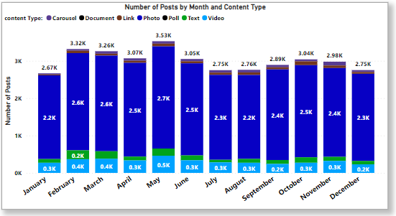
Insights
Notes:
From our analysis, you can see that May, was the most engaging time of the year with about 3526 engagements. Holidays, warmer weather
and major events could be some of the reasons for May having higher engagements with higher number of posts in this time of the year.

Slide 11
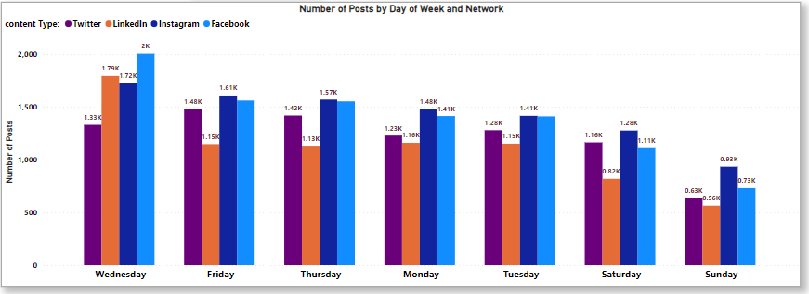
Insights
Notes:
Additionally, from the combined social media dataset you can see from this chart that wednesday comes tops as the favorite time of post with facebook having over 2000 posts and instagram with about 17200 posts. This is also consistent with the average engagement rates of users per week across the multiple social media platforms.

Slide 12
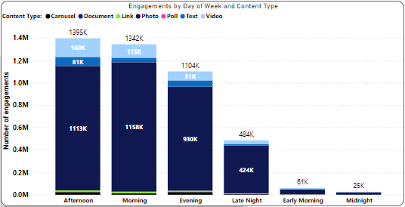
Insights
Notes:
Also from the combined social media dataset, Afternoon was also the most engaging time of the day for users. Peak alertness, work schedule, lunch breaks, time zones and content posting schedule are some of the deduced reasons for this.

Slide 13
Summary
ANALYSIS
Photo content type, in conjunction with Wednesdays at noon, emerged as the most favored combination, both for user engagement and post interactions.
INSIGHTS
Maximize user engagement and post interactions by shifting to photo-centric posts on Wednesdays at noon. Allocate a significant portion of your content calendar to planning, creating, and curating visually appealing photo content that aligns with Playhouse communications brand identity and marketing goals.
NEXT STEPS:
This ad-hoc analysis is insightful, but it time to take this analysis into large scale production for real-time understanding of your business.
Notes:
So to summarize
We tackled this task and found that photo contents were the most popular content type, but we also went one step further.
I found that wednesdays were the most popular days for post engagements.
We also found that afternoons are the most time of day for post engagements. This could be a signal to users social media engagement pattern for those using the 4 platforms and you could use this to boost engagement even further. For example, you could run a campaign with photo contents focused a strategic moment when engagement potential is at its zenith.
As much as this analysis was insightful, I am ready to take this to the next stage and I have the expertise Playhouse communications needs to help realize these kinds of insights in production across your social media platforms an in real-time. I would love to help you with this.

Slide 14
Thank you
Any Questions?
Notes:
Thank you very much for listening, please feel free to ask any questions that you may have!

